Slide 2
Intro on Venture Capital and
Red River West

Slide 3



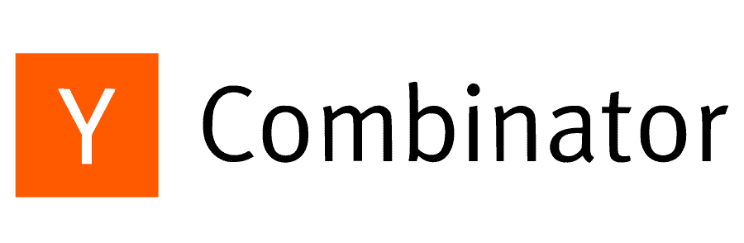











What is Venture Capital ?
Venture capital (VC) is generally used to support startups and other businesses with the potential for substantial and rapid growth. VC firms raise money from limited partners (LPs) to invest in promising startups.
A venture capital investment by its nature is risky and takes place before a company goes public or, in early-stage companies, even before a company has an established track record. The possibility of large losses is factored into the VC’s business model. VCs anticipate that they’ll lose money on most investments. The odds of hitting a “home run,” earning over 10X the venture capital investment, are small and can take years to realize. The calculation is that a few successful companies can pay dividends that far offset the losses (we call it the power law).
> 30k VC funds globally
Financed > 150k companies
Notes:
German funds with US Presence : Picus, Headline, 468, Target Global, DTCP, Apollo Heatlh all data available here:
https://www.dropbox.com/scl/fi/h15yusxtcixmvspqhfmd8/German-VC-funds.xlsx?rlkey=20lu8cvehkbblln76oivi4sej&dl=0
Mise Spanish funds with US Presence: Alma Mundi, Conexo,
French funds with US Presence: Cathay, Partech, Hardware Club, Whitestar, AXA, Ring

Slide 4
How does Venture Capital work ?
Bankruptcy
Management company
In most case startups fail, and VCs make no return on investment
Portfolio
Limited Partners
Startup 1
Venture Capital
fund 1
Startup 2
LPs invest in VC funds with the hope of getting back at least 2x their investment in 10 to 12 years
VC funds invest in startups that become part of their portfolio
Startup 3
VCs can get rewarded via “carried interest” on the overall performance of the fund
Exit
When an exit is done, LPs recover their share of the generated cash.
VCs can exit from startups via a sale, an IPO, or a secondary investment
Notes:
German funds with US Presence : Picus, Headline, 468, Target Global, DTCP, Apollo Heatlh all data available here:
https://www.dropbox.com/scl/fi/h15yusxtcixmvspqhfmd8/German-VC-funds.xlsx?rlkey=20lu8cvehkbblln76oivi4sej&dl=0
Mise Spanish funds with US Presence: Alma Mundi, Conexo,
French funds with US Presence: Cathay, Partech, Hardware Club, Whitestar, AXA, Ring

Slide 5
Who we are at Red River West
Red River West is a European/US VC firm that invests in startups from Series A aiming to expand into the US to reach global leadership. Our team consists of ex-founders (App Annie, Purch, etc.) distributed between the EU and the US.
Our specificities :
Focus on Series B companies: we invest in companies that often do more than 5M€ of revenues and that are raising rounds from 10 to 50M€
Sector agnostic: we invested in companies across various verticals, from space tech to fintech, AI, SaaS, etc.
We are hands-on and half of the team is composed of senior entrepreneurs who support the startups we invest in.
We focus on helping European startups scale in the US.
We have our own tech & data team building one of the top platforms in the industry
Notes:
German funds with US Presence : Picus, Headline, 468, Target Global, DTCP, Apollo Heatlh all data available here:
https://www.dropbox.com/scl/fi/h15yusxtcixmvspqhfmd8/German-VC-funds.xlsx?rlkey=20lu8cvehkbblln76oivi4sej&dl=0
Mise Spanish funds with US Presence: Alma Mundi, Conexo,
French funds with US Presence: Cathay, Partech, Hardware Club, Whitestar, AXA, Ring

Slide 6
















Red River West development timeline
Our first fund invested in 9 startups
In 2021, we became a financial institution regulated by the AMF, expanded the team and started raising our second fund, aiming for 200€M+
We invested in 2 companies yet with our second fund
Red River West was founded by European entrepreneurs who already scaled a company in the US and the “Groupe Artemis”, owner of Kering, the second biggest luxury group in the world. We raised the first 120€M fund in 2017.
2017
2021
Notes:
German funds with US Presence : Picus, Headline, 468, Target Global, DTCP, Apollo Heatlh all data available here:
https://www.dropbox.com/scl/fi/h15yusxtcixmvspqhfmd8/German-VC-funds.xlsx?rlkey=20lu8cvehkbblln76oivi4sej&dl=0
Mise Spanish funds with US Presence: Alma Mundi, Conexo,
French funds with US Presence: Cathay, Partech, Hardware Club, Whitestar, AXA, Ring

Slide 7
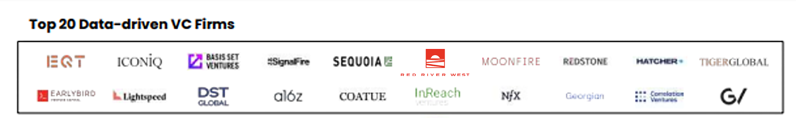
Our Proprietary Software augments our team by using big data and machine learning to spot hypergrowth startups
Constant scanning of hundreds data points in real time for more than 25,000 startups in Europe
Incorporating ESG criteria and adding new data points and sources constantly
3 dedicated in-house, best-in-class data-scientists and developers
Constant improvement of algorithms
Machine learning and NLP proprietary algorithms to create custom growth indexes
In May 2023, RRW was listed amount the Top20 Data driven VC⁽¹⁾ firms in the world alongside a16z, Sequoia, Tiger Global, EQT…
(1) Data-driven VC Landscape 2023 – 9 May 2023 (Earlybird, Affinity, Synaptic, Vauban)

Slide 8
Project intro & goal

Slide 9
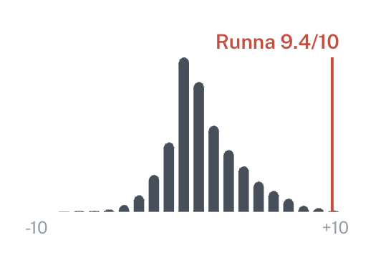

Our goal is to be able to evaluate the performance of a fund
We want to be able to evaluate easily the performance of any fund to get more insights on who are the best investors, how we perform against them, etc.
We also want to create a product that we will provide to our LPs and that will help them find and invest in the best funds. This product will need to leverage a module like the one you will be building.
That’s why we want to create a module that will evaluate the performance of any VC fund based on their investments and how they performed.
More than the exact return of the fund (that might be impossible to calculate with great accuracy), we want to get a metric that we will be able to compare across funds in order to spot top decile funds.
Notes:
German funds with US Presence : Picus, Headline, 468, Target Global, DTCP, Apollo Heatlh all data available here:
https://www.dropbox.com/scl/fi/h15yusxtcixmvspqhfmd8/German-VC-funds.xlsx?rlkey=20lu8cvehkbblln76oivi4sej&dl=0
Mise Spanish funds with US Presence: Alma Mundi, Conexo,
French funds with US Presence: Cathay, Partech, Hardware Club, Whitestar, AXA, Ring

Slide 10
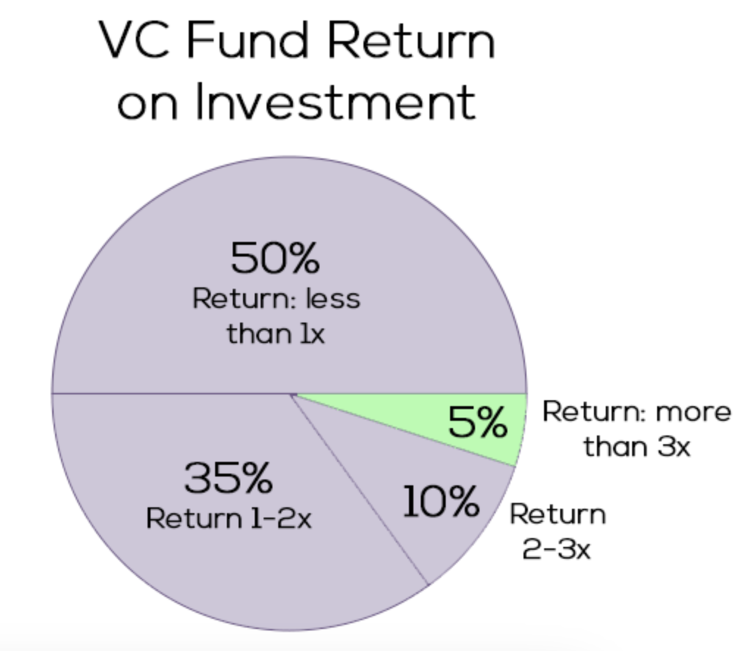
How do you calculate the performances of a VC firm?
Venture Capital is a risky investment, and most VC funds don’t deliver great performances. To deliver a great return, a fund has to be in the top decile of all funds operating. There are multiple ways to calculate the return of a VC firm :
RVPI (Residual Value to Paid-In Capital): RVPI measures the current value of remaining investments in the fund relative to the paid-in capital. It's a snapshot of the unrealized value.
Calculation: RVPI = (Residual Value / Paid-In Capital)
DPI (Distributed to Paid-In Capital): DPI focuses solely on the realized portion of the fund's return, indicating how much capital has been returned to investors.
Calculation: DPI = (Distributions / Paid-In Capital)
TVPI (Total Value to Paid-In Capital): TVPI combines both realized and unrealized returns, offering a comprehensive view of the fund's performance.
Calculation: TVPI = DPI + RVPI
MOIC (Multiple on Invested Capital): MOIC measures the total value created by an investment relative to the amount of capital invested. It indicates how many times the investment value increased. A MOIC of 2x means that the investment has doubled in value.
Calculation: MOIC = (Total Value / Invested Capital)
IRR : IRR is the annualized rate of return that sets the net present value (NPV) of all cash flows (both positive and negative) from an investment to zero. It accounts for the timing of each cash flow
Notes:
German funds with US Presence : Picus, Headline, 468, Target Global, DTCP, Apollo Heatlh all data available here:
https://www.dropbox.com/scl/fi/h15yusxtcixmvspqhfmd8/German-VC-funds.xlsx?rlkey=20lu8cvehkbblln76oivi4sej&dl=0
Mise Spanish funds with US Presence: Alma Mundi, Conexo,
French funds with US Presence: Cathay, Partech, Hardware Club, Whitestar, AXA, Ring

Slide 11

We will try to estimate the TVPI of funds by leveraging Pitchbook data
Why focus on TVPI?
The cycle of life of a VC fund is long and while the fund is not closed, DPI is not always the best way to evaluate the performance of a fund as it doesn’t account for all the participations that were not sold. By calculating the TVPI, we will be able to get the full picture of the performance of any fund. We will also be able to calculate the DPI pretty easily because we have to calculate the cash returned to investors to get our TVPI.
How do we want to do it?
In most cases, these performance data are not available online and are quite confidential. But, by leveraging some proxy data points, we believe it is possible to estimate these performances to be able to evaluate any VC fund.
You will be leveraging Pitchbook to build models that will allow you to estimate the TVPI of any fund. In some cases, you will have access to the real performances of some funds (for around 5% of the funds these data are public on Pitchbook). You will be able to leverage that + all the other data points that you will gather from Pitchbook to build a model and backtest it.
Notes:
German funds with US Presence : Picus, Headline, 468, Target Global, DTCP, Apollo Heatlh all data available here:
https://www.dropbox.com/scl/fi/h15yusxtcixmvspqhfmd8/German-VC-funds.xlsx?rlkey=20lu8cvehkbblln76oivi4sej&dl=0
Mise Spanish funds with US Presence: Alma Mundi, Conexo,
French funds with US Presence: Cathay, Partech, Hardware Club, Whitestar, AXA, Ring

Slide 12
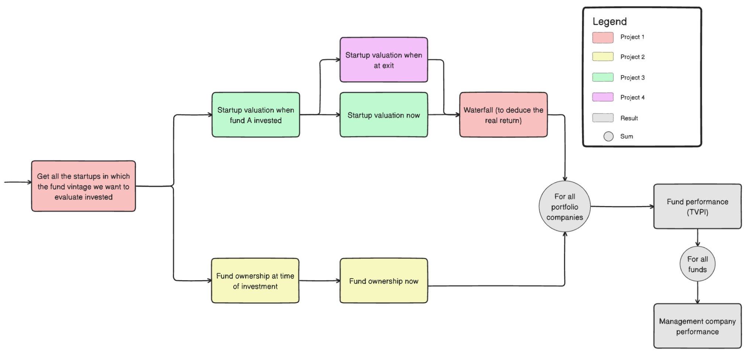
To calculate the performance of the fund, we will compare the valuation of each company at the time of investment VS now
Notes:
German funds with US Presence : Picus, Headline, 468, Target Global, DTCP, Apollo Heatlh all data available here:
https://www.dropbox.com/scl/fi/h15yusxtcixmvspqhfmd8/German-VC-funds.xlsx?rlkey=20lu8cvehkbblln76oivi4sej&dl=0
Mise Spanish funds with US Presence: Alma Mundi, Conexo,
French funds with US Presence: Cathay, Partech, Hardware Club, Whitestar, AXA, Ring

Slide 13
We have separated the project into 4 different sub-projects
To give you more time to focus on a particular part of the project, we split it into 4 distinct sub-projects. The entier project will take place in 4 phases :
During the first week, you will be able to explore the data and perform statistics on it
During the next 4 weeks, you will create each week a very basic version of each sub-projects
Then, during the next 6 weeks your team will focus on one of the sub-projects (at least 2 teams per sub-project)
Finally, in the last weeks, you will put everything together to arrive to a final result
Notes:
German funds with US Presence : Picus, Headline, 468, Target Global, DTCP, Apollo Heatlh all data available here:
https://www.dropbox.com/scl/fi/h15yusxtcixmvspqhfmd8/German-VC-funds.xlsx?rlkey=20lu8cvehkbblln76oivi4sej&dl=0
Mise Spanish funds with US Presence: Alma Mundi, Conexo,
French funds with US Presence: Cathay, Partech, Hardware Club, Whitestar, AXA, Ring

Slide 14
We have separated the project into 4 different sub-projects
To give you more time to focus on a particular part of the project, we split it into 4 distinct sub-projects.
You and your team will focus on one particular sub-project while building a very basic version of the other sub-projects (allowing you to get the full picture). At least 2 teams will focus on each sub-project, and in the end, we will put in common all the work to build the best fund return estimation tool possible.
Project 1:
Part 1: get all the startups in which the fund vintage we want to evaluate invested
Part 2: get the investment waterfall / real exit multiple from the valuation & amount raised
Project 3:
Estimate the valuation of a startup after a financing round
Project 2:
Estimate the fund ownership in any startup
Project 4:
Generate statistics on all the different aspects of the project and focus on acquired startups to try to approximate the valuation of acquisitions.
Notes:
German funds with US Presence : Picus, Headline, 468, Target Global, DTCP, Apollo Heatlh all data available here:
https://www.dropbox.com/scl/fi/h15yusxtcixmvspqhfmd8/German-VC-funds.xlsx?rlkey=20lu8cvehkbblln76oivi4sej&dl=0
Mise Spanish funds with US Presence: Alma Mundi, Conexo,
French funds with US Presence: Cathay, Partech, Hardware Club, Whitestar, AXA, Ring

Slide 15
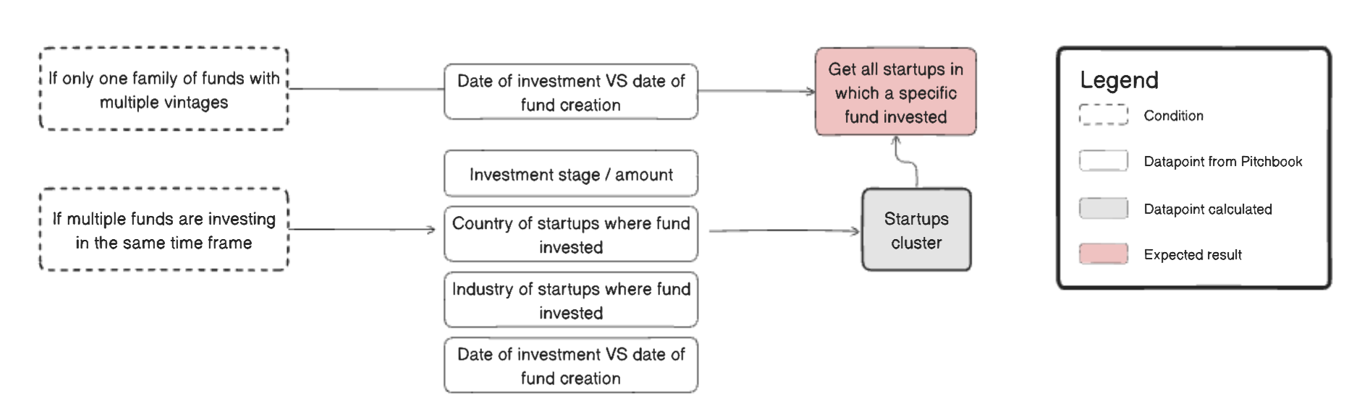
Project 1 - part 1
Get all the startups in which the fund vintage we want to evaluate invested
Context : A VC fund like Sequoia Capital, Red River West, or Founders Fund is a “management company” that is often composed of multiple funds. For example, at Red River West we have two funds with the same strategy: Red River West I and Red River West II. Each fund often has a period of investment of 3 to 5 years with a dedicated amount under management. So when a fund has invested all of its money, the management company needs to raise another fund that will succeed the previous one.
Also, some management companies like Sequoia Capital often have multiple funds operating at the same time with different strategies. Most of the time, you have 3 different types of reasons why you want to have different funds :
Stage of investment : you can have one fund investing late stage and another one focusing on early-stage startups
Geography : some management companies have one fund investing in Europe and another one investing in the US for example.
Sector : some management companies have different funds that focus on different sectors like AI or Fintech.
How to do it : For each management compay, you will find one or multiple funds in Pitchbook. In some cases, you will know exactly which fund invested in a particular company, but in most cases, you won’t. Your job will be to determine that in order to evaluate any fund.
Basic version : do it only for management company that never had more than 1 fund operating at the same time
Full version : do it for every management companies including the ones having sectorial, stage, and geography-focused funds
Notes:
German funds with US Presence : Picus, Headline, 468, Target Global, DTCP, Apollo Heatlh all data available here:
https://www.dropbox.com/scl/fi/h15yusxtcixmvspqhfmd8/German-VC-funds.xlsx?rlkey=20lu8cvehkbblln76oivi4sej&dl=0
Mise Spanish funds with US Presence: Alma Mundi, Conexo,
French funds with US Presence: Cathay, Partech, Hardware Club, Whitestar, AXA, Ring

Slide 16
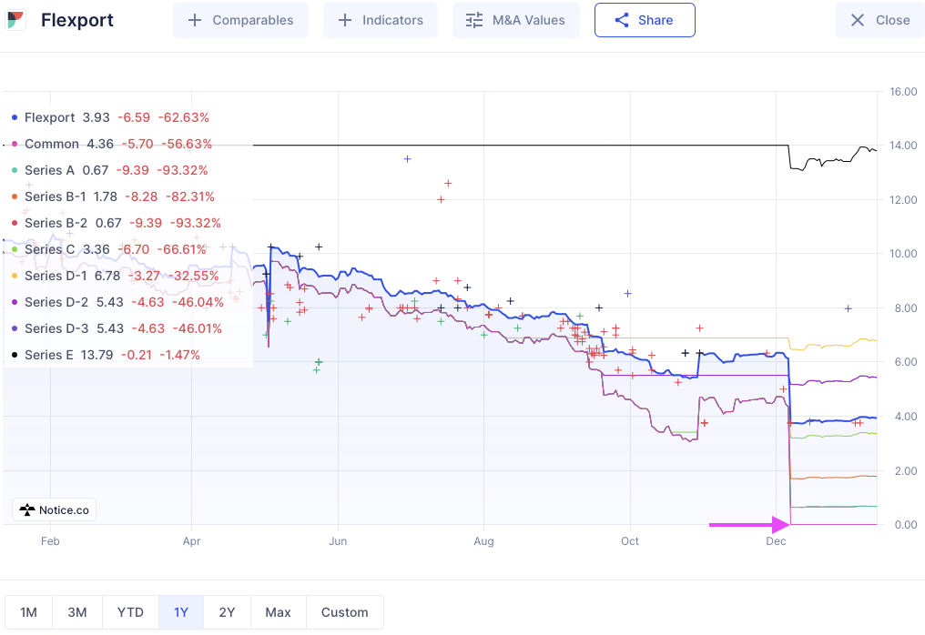
Project 1 - part 2
Get the investment waterfall / real exit multiple from the valuation & amount raised
Context: In most cases, when VC invest in startups, they get preferred stock, which is a class of equity that typically grants certain advantages over common stock (usually held by founders and employees). One key feature often associated with preferred shares is the liquidation preference. This gives preferred shareholders the right to get paid before common shareholders when the company is sold or liquidated.
You often have multiple layers of preferred shares (e.g the Series A investors are paid before Seed investors who are paid before common shareholders).
In the example of Flexport, you can see that if a valuation is inferior to the amount raised, common shares can have a value of 0, while the shares held by VCs will fluctuate depending on the round in which they invested.
It can have a significant impact on VC returns so we need to take it into account.
0
- 100%
How to do it : we need to estimate the real return of a fund by applying a coefficient to this return depending on the ratio amount raised / startup valuation.
Basic version : just handle the case where valuation < amount raised. Depending on the amount invested after fund investment, determine the multiple
Complete version : also handle the case where valuation > amount raised but they are close.
Notes:
German funds with US Presence : Picus, Headline, 468, Target Global, DTCP, Apollo Heatlh all data available here:
https://www.dropbox.com/scl/fi/h15yusxtcixmvspqhfmd8/German-VC-funds.xlsx?rlkey=20lu8cvehkbblln76oivi4sej&dl=0
Mise Spanish funds with US Presence: Alma Mundi, Conexo,
French funds with US Presence: Cathay, Partech, Hardware Club, Whitestar, AXA, Ring

Slide 17
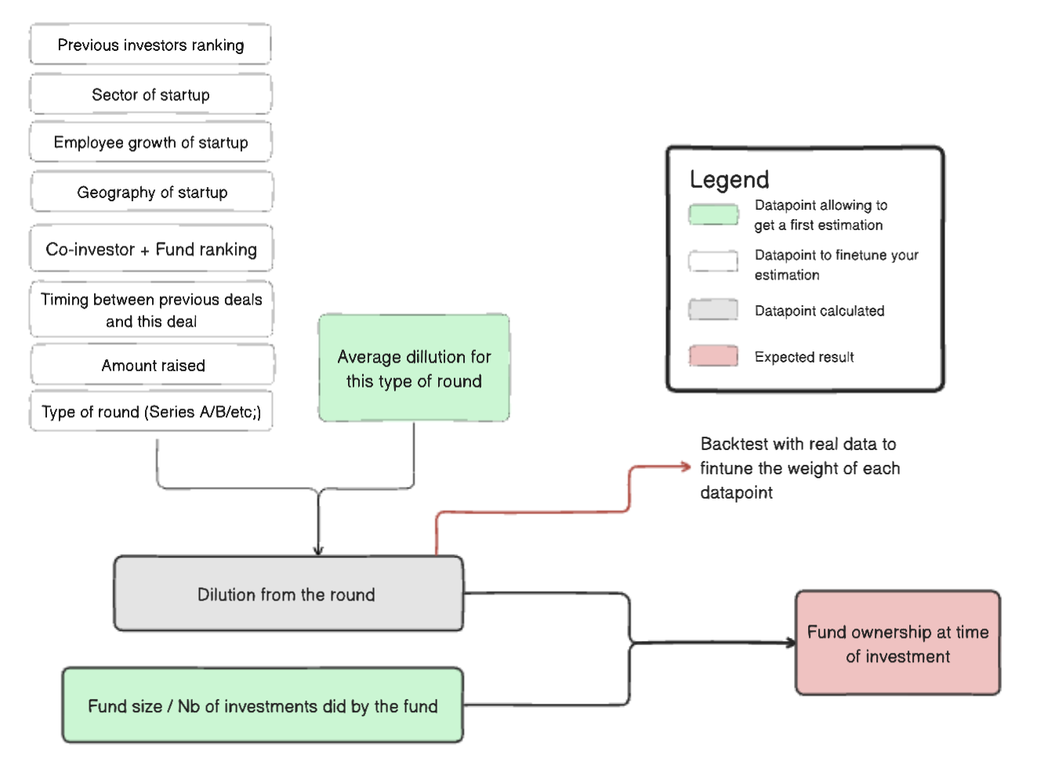
Project 2
Estimate the fund ownership
Context: In order to calculate the return of a fund in a particular investment, you will need to calculate its ownership on the underlying company.
How to do it: In some cases you will have this ownership available in Pitchbook data, in most cases you won’t.
Basic version : use the average dilution for this type of round. If the fund is alone in the round, use this as the fund ownership, if not us the fund size / nb of investments did by the fund to get the mean size of ticket and use the ticket / total round size to get the % of the round the fund have.
Complete version : improve the basic version by taking into account the role of the fund in the round (lead or follower) and multiple other criterias to finetune the ownership + backtest it with real data.
Notes:
German funds with US Presence : Picus, Headline, 468, Target Global, DTCP, Apollo Heatlh all data available here:
https://www.dropbox.com/scl/fi/h15yusxtcixmvspqhfmd8/German-VC-funds.xlsx?rlkey=20lu8cvehkbblln76oivi4sej&dl=0
Mise Spanish funds with US Presence: Alma Mundi, Conexo,
French funds with US Presence: Cathay, Partech, Hardware Club, Whitestar, AXA, Ring

Slide 18
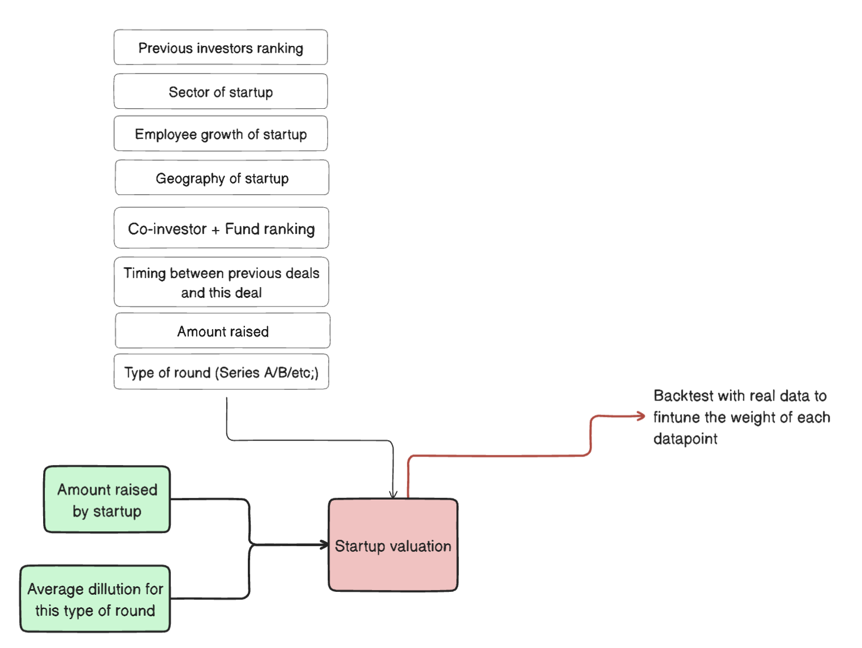
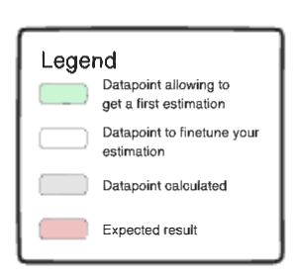
Project 3
Estimate the valuation of a startup after a financing round
Context: To calculate the return of a fund (RVPI) in a particular investment not yet exited, you will need to calculate its value.
How to do it: In some case you will have this valuation available in Pitchbook data, in most cases you won’t.
Basic version : use the average dilution for this type of round. Use the amount raised and the average dilution (next slide).
Complete version : improve the basic version by taking into account sector, geography, and multiple other criteria to finetune + backtest it with real data.
Notes:
German funds with US Presence : Picus, Headline, 468, Target Global, DTCP, Apollo Heatlh all data available here:
https://www.dropbox.com/scl/fi/h15yusxtcixmvspqhfmd8/German-VC-funds.xlsx?rlkey=20lu8cvehkbblln76oivi4sej&dl=0
Mise Spanish funds with US Presence: Alma Mundi, Conexo,
French funds with US Presence: Cathay, Partech, Hardware Club, Whitestar, AXA, Ring

Slide 19
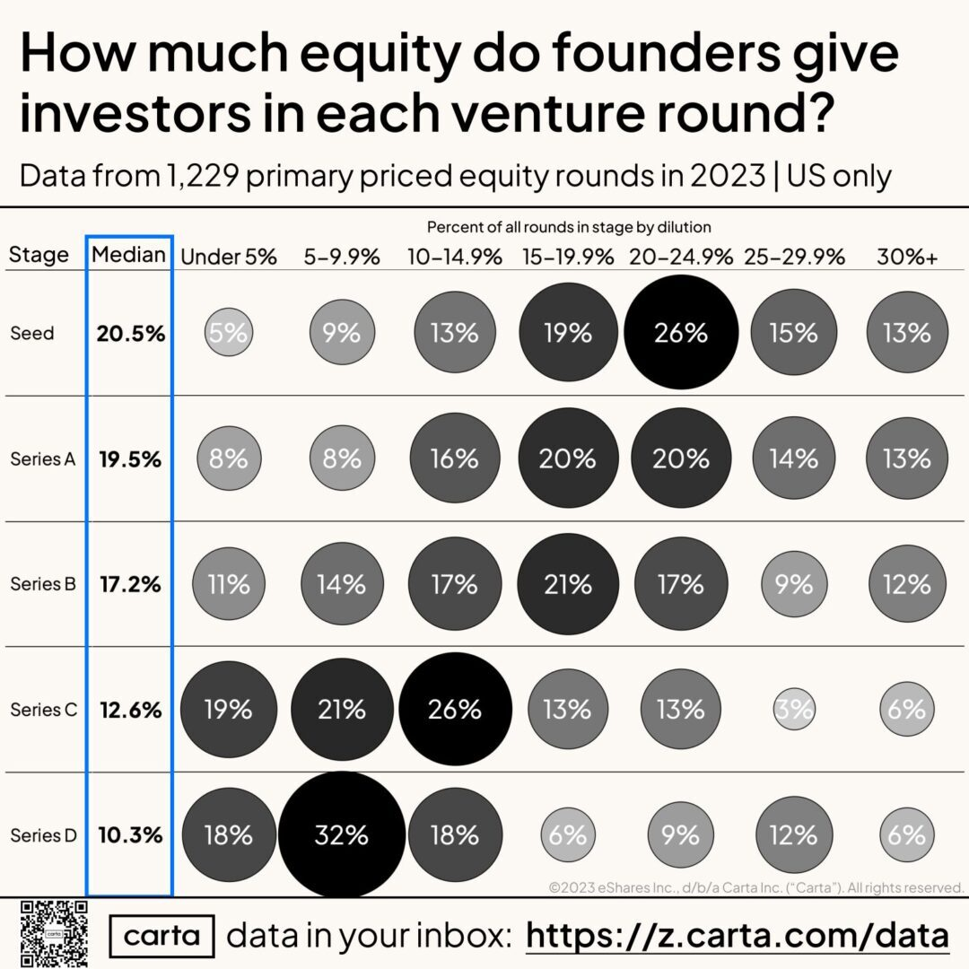
Project 2 & 3 - Ownership benchmarks
You can use these benchmarks to calculate the the basic version of the ownership of each fund + the the valuation of startups
Notes:
German funds with US Presence : Picus, Headline, 468, Target Global, DTCP, Apollo Heatlh all data available here:
https://www.dropbox.com/scl/fi/h15yusxtcixmvspqhfmd8/German-VC-funds.xlsx?rlkey=20lu8cvehkbblln76oivi4sej&dl=0
Mise Spanish funds with US Presence: Alma Mundi, Conexo,
French funds with US Presence: Cathay, Partech, Hardware Club, Whitestar, AXA, Ring

Slide 20
Project 4
Generate statistics on all the different aspects of the project and focus on acquired startups to try to approximate the valuation of acquisitions.
Context: Most of the time, VCs can have 3 different types of exits : IPO, selling the company, and selling shares to other investors. We need to get the exit valuation if we want to cover all investment lines of a fund.
For the IPO, it’s quite straightforward and you will get the informations in Pitchbook
When the company is sold, in some cases you will have the data, but in a lot of cases you won’t.
Goal: your goal is to create statistics on exits and particularly on acquisitions to try to find a way to include them into the calculation of the returns. You can try different methods to approximate this valuation by real valuations and comparing it with the number of employees, the type of acquirer, the amount of the last round, etc.
Notes:
German funds with US Presence : Picus, Headline, 468, Target Global, DTCP, Apollo Heatlh all data available here:
https://www.dropbox.com/scl/fi/h15yusxtcixmvspqhfmd8/German-VC-funds.xlsx?rlkey=20lu8cvehkbblln76oivi4sej&dl=0
Mise Spanish funds with US Presence: Alma Mundi, Conexo,
French funds with US Presence: Cathay, Partech, Hardware Club, Whitestar, AXA, Ring

